Slide 1


Premier Forum Hydrometeorologique Afrique Centrale
WASCAL/UFHB
WASCAL, as an inescapable tool for capacity building, research and data management over West Africa
Prof. KONE Daouda
(Director of WASCAL/CEA-CCBAD, UFHB, Cote d’Ivoire)

Slide 2
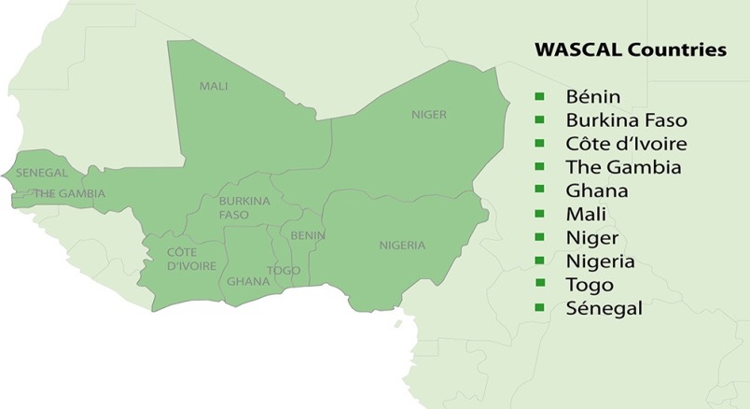
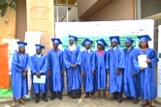
WASCAL PROGRAMME
WASCAL (West African Science Service Center on Climate Change and Adapted Land Use) is a large-scale research-focused Climate Service Center designed to help tackle this challenge and thereby enhance the resilience of human and environmental systems to climate change and increased variability.
Cabo verde
GSP on Informatics for Climate Change in Burkina Faso and Climate Change and Marine Sciences in
The activities of the WASCAL Graduate Research Program (GRP) are set up and managed based on a partnership between 10 West African and German universities and research institutes.
https://www.wascal.org

Slide 3
WASCAL PROGRAMME
WASCAL is an initiative of the German Ministry of Education and Research (BMBF)established to help West African countries tackle the challenges of CC adaptation through capacity building and scientific research.
The training of highly qualified people, together with adequate infrastructure and equipment, is required to strengthen scientific knowledge on biodiversity, agriculture and climate interactions.
The mission of this program is to provide training on state of the art tools used in climate change impact assessments with the view of deriving useable climate change scenarios in WASCAL thematic areas that can propose adaptation and mitigation solutions and guide policy formulation across the region.

Slide 4
WASCAL COMPONENTS
Capacity Building Program
Established regional graduate research programs on priority climate change topics
Training,
Doctoral Programme
Competence Center in Ouagadougou
coordinate and carry out collection of data
Meteorological
Hydrological
Land
Biodiversity
Household
Socio-economics
Core Research Program
strengthen the analytical capability of the
Competence Center
Conceptual Framework: Resilience of
social-ecological systems
Small watersheds (100 km2)
Different land use intensity

Slide 5
Graduate Studies Programme
West African Climate System
Federal University of Technology
Akure, Nigeria
Climate Change and Water Resources
Kwame Nkruma University
Kumsi, Ghana
Climate Change Economics
Universite Cheick Anta Diop
Dakar, Senegal
Climate Change and Land Use
Kwame Nkrumah University of Science and Technology; Ghana
Climate Change and Agriculture
L’Institut Polytechnique Rural de Formation et de Recherche Appliquée, Mali
Climate Change and Biodiversity
Universiiite Felix Houphouet
Abidjajn , Cote d’Ivoire
Climate Change and Human Security
University of Lomé
Togo
Climate Change and Adapted Land Use
Federal University of Technology, Minna, Nigeria
Climate Change and Energy
Université Abdou Moumouni de Niamey, Niger
Climate Change and Education
University of The Gambia (UTG)
Gambia
GSP on Informatics for Climate Change in Burkina Faso and Climate Change and Marine Sciences in Cabo Verde

Slide 6
Training & Capacity Building
WASCAL ONs Unit supported the development of the national framework for climate services of Burkina Faso;
Co-organized and co-facilitated the forum of the West African seasonal forecasting (PRESASS-2016, 2017, 2018),
COSPAR/NASA summer school (2017),
Students’ internship and training of technicians of partners institutions involved in observations and related services.

Slide 7
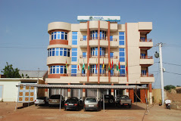
Data Management
Within WASCAL a large number of heterogeneous data are collected
Different initiated research activities within WASCAL (Core Research Program, Graduate School Program)
The hydrological-meteorological, remote sensing, biodiversity and socio economic observation networks within WASCAL,
The activities of the WASCAL Competence Center in Ouagadougou, Burkina-Faso
WASCAL Competence Center in Ouagadougou, Burkina-Faso

Slide 8
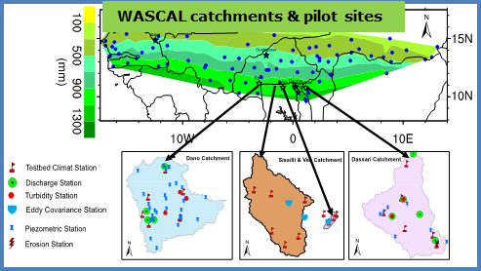
WASCAL Observation Networks Unit (WASCAL ONs)
WASCAL ONs is a multi-stakeholder framework of observatories & sensors which shares data, co-designs and co-implements observation activities such as
Rehabilitation of sites
Increasing the number of stations;
Digitizing paper/microfiche archives of data;
Improving data processing techniques; and
Train technical staff involved in observations & related services. r

Slide 9
WASCAL Observation Networks Unit (WASCAL ONs)
WASCAL ONs include :
Transboundary climate observation (ReCON),
Regional hydrology observation network (ReHON),
Biodiversity observation network (BON),
Regional socio-economics observation network (ReSON),
Land surveys & remote sensing observation network (RSON).
Coordination unit at WASCAL CoC, each observation network is led by a focal point.

Slide 10
WASCAL Observation Networks Unit (WASCAL ONs)
Developed & coordinated the implementation of a harmonized work plan for all components and related capacity building programs (internships, field excursions, sensors maintenance, training of technician, etc.);
Supported the procurement process, sup-ply, testing for technical compliance;
Completed training of technicians, deployment and installations in WASCAL countries;

Slide 11
WASCAL Observation Networks Unit (WASCAL ONs)
Provided technical support to the forum of the West African seasonal forecasts for the Sahel region i.e. PRE-SASS;
Kept on monitoring the sensors, collecting data, post-processing, analysing and uploading the collected da-ta to WADI Geoportal

Slide 12
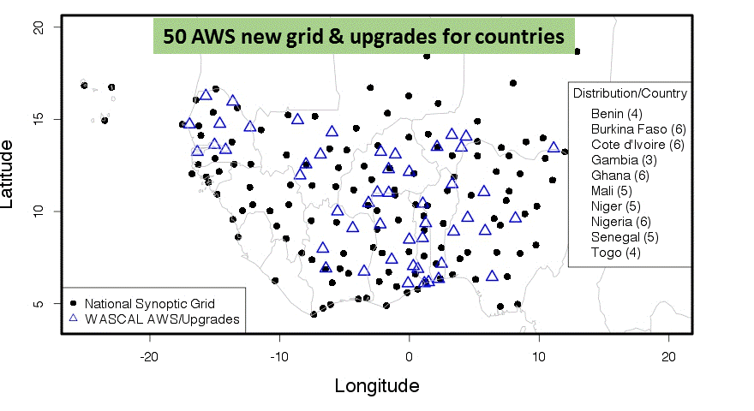
Elaborated the technical specifications for the acquisition of fifty automatic weather stations (AWS), sixty automatic hydrological sensors (AHS);

Slide 13
Thank YOU

