Slide 1
Leveraging public-private partnerships for sustainability of enhanced national weather information services
Mohammade Check
16 November 2018

Slide 2


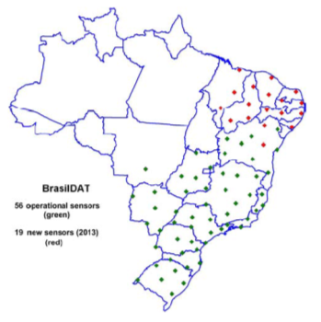

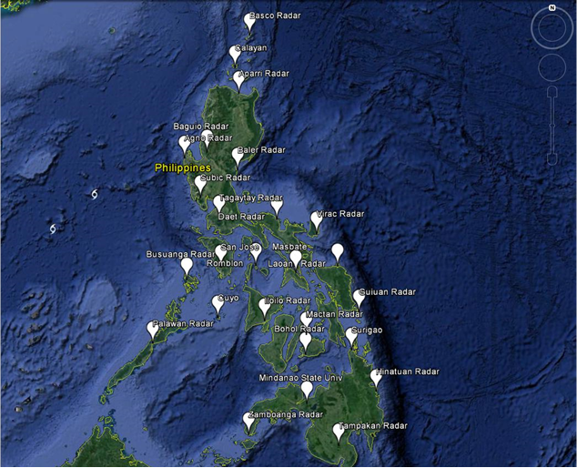



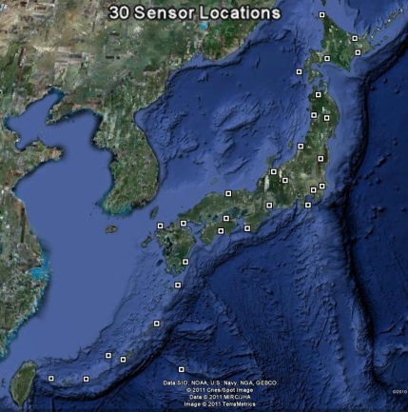
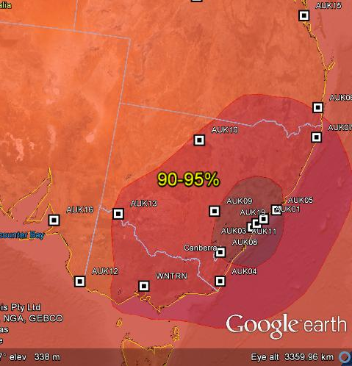


A Top Provider to National and International Organizations
India – MOD, MOES, States of West Bengal, Karnataka, and Andhra Pradesh
Brazil – INPE
Japan – JMA
Australia – BOM (with WeatherZone)
Philippines – PAGASA
UNDP – Uganda, Liberia, Sierra Leone, The Gambia

Slide 3
Public Private Partnership Aspect of the Business Model

Slide 4
Conditions for Sustainable Program Development
Fit for Context Technology
Multi-Year Project Investment
Public Private Partnerships
Data Rights to Enable the PPPs
Multi-Stakeholder Approach

Slide 5
Challenges Facing National Met Agencies in LDCs
Budgets
Government budgets are very limited
People
Limited technical skills and resources
Technology
Services
Sporadic donor funded programs
Lack of professional, empowered staff
Technology mismatch with capacity
Basic operational constraints
Inability to deliver services
Uniformed vulnerable communities
Lack of credibility

Slide 6
Public Private Partnership to Enhance NMHS Infrastructure, Capacity and Sustainability
Co-Investment in
EWS Infrastructure
Guaranteed Ongoing Operation of EWS
Joint Go-To-Market Shared Cost Recovery

Slide 7
Summary of Key Terms and Conditions of PPP MOU
Co-Investment into NMHS-Owned EWS Network
EWS Equipment Ownership
Data Ownership/License
Data Ownership/Access
NMHS Owns; EN Licenses
Guaranteed Ongoing Operation and Data Service
Service Level Agreement; NMHS Co-funds Annually
Data Ownership/Access
Coordinated Sales and Marketing
Sustainability through
Cost Recovery
XX% NMHS / XX% EN;
In Line with S&M Roles
Revenue Sharing Model

Slide 8
Innovative Public Private Partnership to Enhance NMHS Infrastructure, Capacity and Sustainability
NMHS
Ownership of observation network equipmt
Data license and review/approval of weather information communication
Increased capacity to fully utilize the Early Warning System (EWS)
Shared data creates sustainability model
Earth Networks
Implementation and operation of EWS
Contractually defined data access
Development of end user services and “last mile” content delivery
Sales and marketing with revenue sharing for cost recovery to sustain the EWS
Public Private Partnership
Framework
Local Industries
Purchase data and services developed by Earth Networks , Partner and Met Agency
Industries: Insurance, Aviation, Electrical, Agriculture, Mining, Petroleum, Mobile, and many others

Slide 9
Private-Public Partnership Enables Sustainable Delivery of Met Services
Total Operating Cost of Weather Observing Networks
Aviation/Transportation
Operations & Maintenance
Agriculture
Petroleum
COST
Energy
Infrastructure Investment:
Staffed sites
Instrumentation
Installation
Electricity
Communications
Data centers
Burden Shared by Many
Donors/Gov’t Bear Entire Burden
Insurance
Tourism
NGOs
Donor/Government
Public Model
Partnership Model

Slide 10
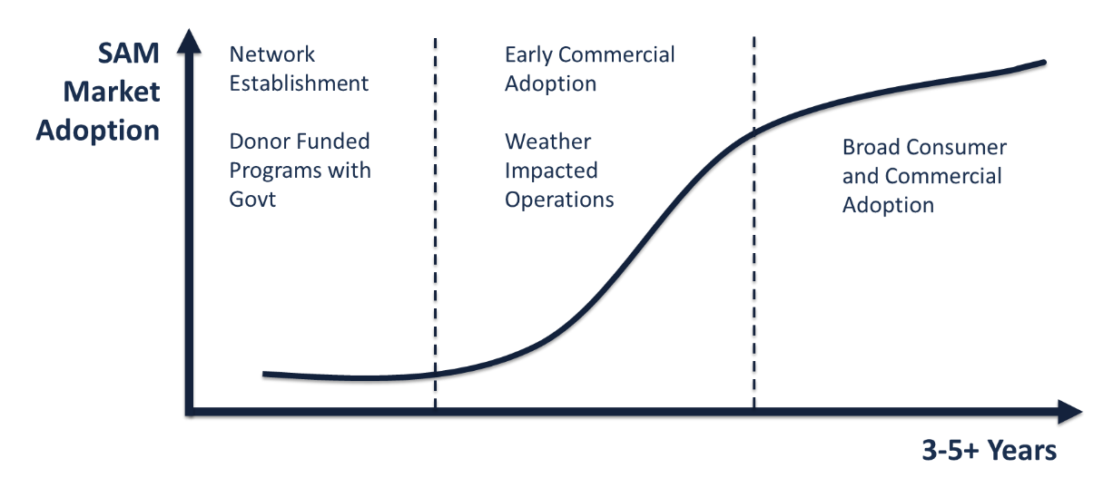
Sales Addressable Market - A Measure of Market Acceptance and Adoption

Slide 11
Update on Implementation in LDCs of Sub-Saharan Africa

Slide 12
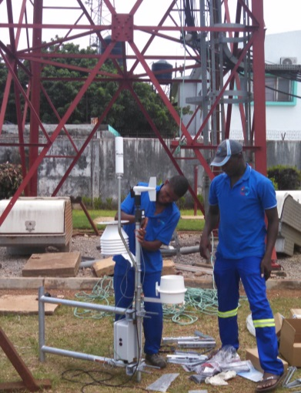
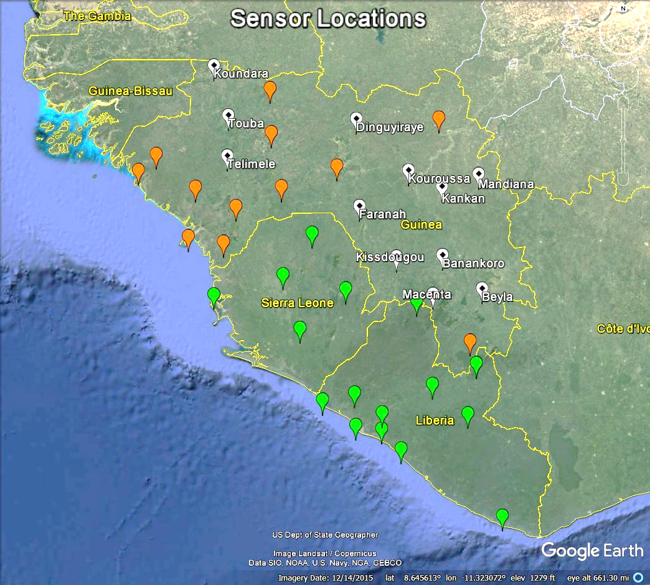
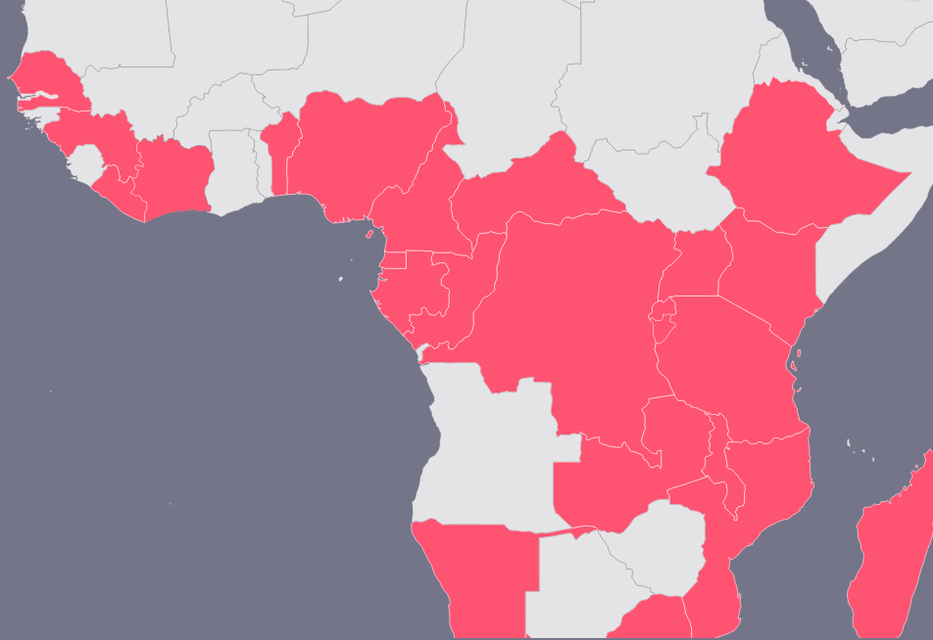
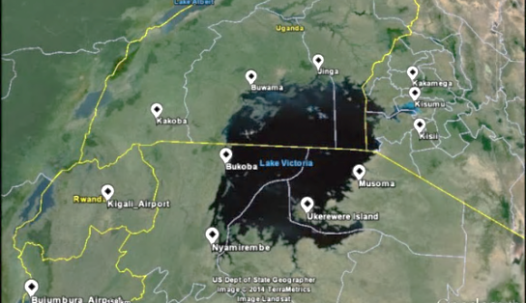

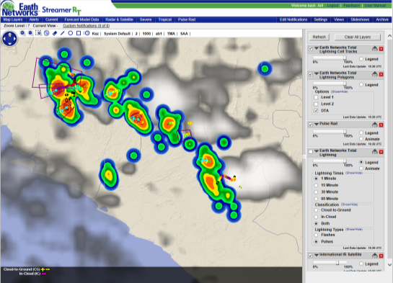
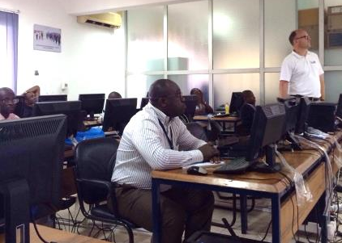
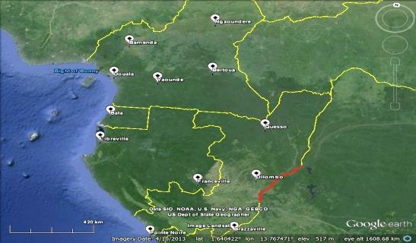
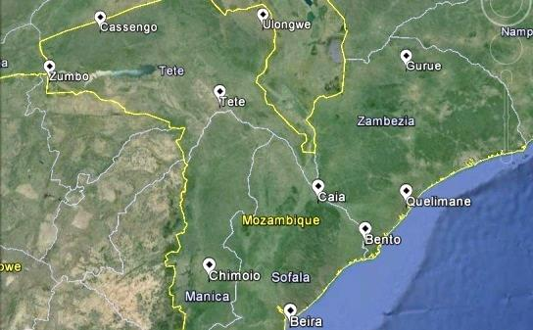




EWS Information Validated in several pilot programs
Guinea, Liberia, Sierra Leone Severe Weather
Early Warning System
Pilot Project in Severe Weather Nowcasting in Lake Victoria Region
Aviation Severe Weather Early Warning System
EWS Pilots in Mozambique and Malawi
AfricaWeather Partnership
Network

Slide 13
Update on Severe Weather Early Warning Systems in Africa
In the Field
All pilot programs moving into next research, operational and scale-up phases
Long-term PPPs finalized with several governments, negotiating more
Focus on sustainability within the multi-user model framework
Interest to join the network from additional UNDP CIEWS countries
Launch of South Africa Total Lightning Network with AfricaWeather
Major scale-up of the ASECNA program to 17 francophone countries
Overall Advocacy
UN Data for Climate Action at COP support to 24 research projects, for 2 of 3 winners
Advocacy for PPP framework – Africa Hydromet Forum, Global Weather Enterprise
Solicitation of new co-investments into broad-based weather PPPs

Slide 14
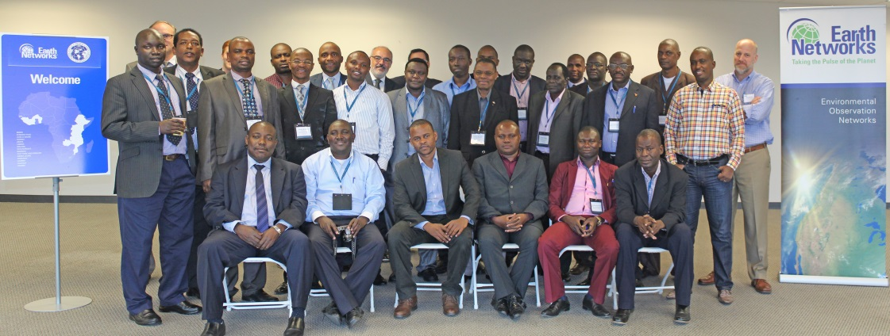
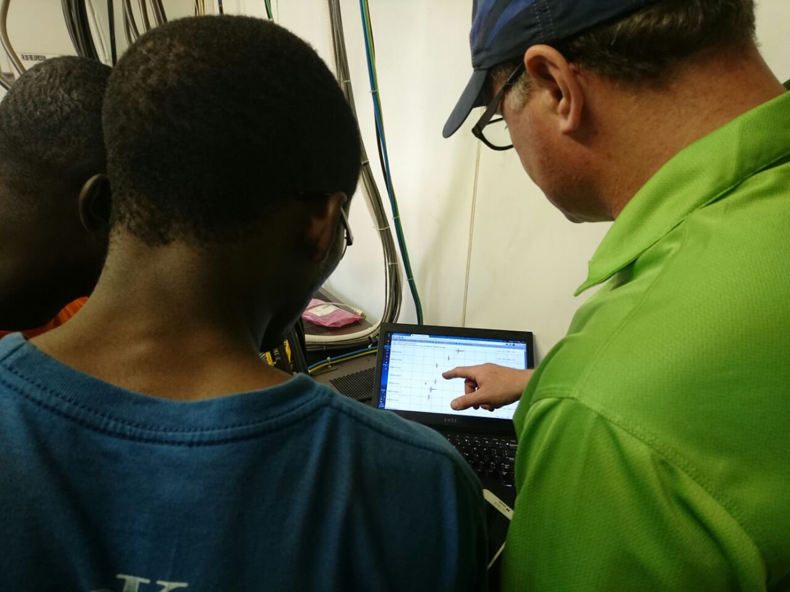
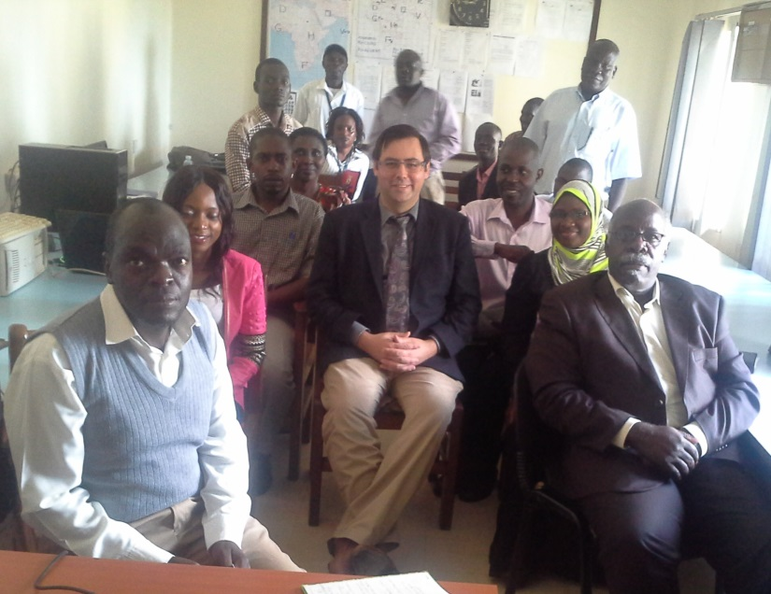
LDC NMHS Training and Capacity Building
NMHS Management Sensitization – Introduction and continued engagement in-country and in United States
Network Field Engineering Training – Train-the-trainer and professional development of technical staff
End-User / Forecaster Training – Multiple engagements enhancing skills in real-time operational severe weather monitoring and alerting
USTDA Training at EN HQ in United States (Oct ‘15)
Hands-on Installation and Training in Uganda
Forecaster Training at UNMA NFC Uganda

Slide 15
Enhancing Capacity to Meet WMO Obligations
WMO Integrated Global Observing System (WIGOS)
Global Framework for Climate Services (GFCS)
Commission for Basic Systems (CBS)
Multi-Hazard Early Warning Systems (MHEWS)
Implementation Plan for Strategy on Service Delivery
WMO Disaster Risk Reduction Strategy
Global Telecommunication System (GTS)
CIMO Guide on Instrumentation
Common Alerting Protocol (CAP)
WMO/WWRP Expert Group on Nowcasting
Aeronautical Meteorological Services Cost Recovery
Role of the Private Sector in Meteorology - WMO Congress 17 Resolution 9.6/1 (Cg-17)

