Slide 1

GFCS Status
ECCAS Hydromet Forum
14-16 November 2018
Libreville, Gabon
Office of Development Partnerships
Cabinet and External Relations Department
dpo@wmo.int

Slide 2





Vision
To enable better management of the risks of climate variability and change and adaptation to climate change, through the development and incorporation of science-based climate information and prediction into planning, policy and practice on the global, regional and national scale.”
Priority Areas
Energy

Slide 3

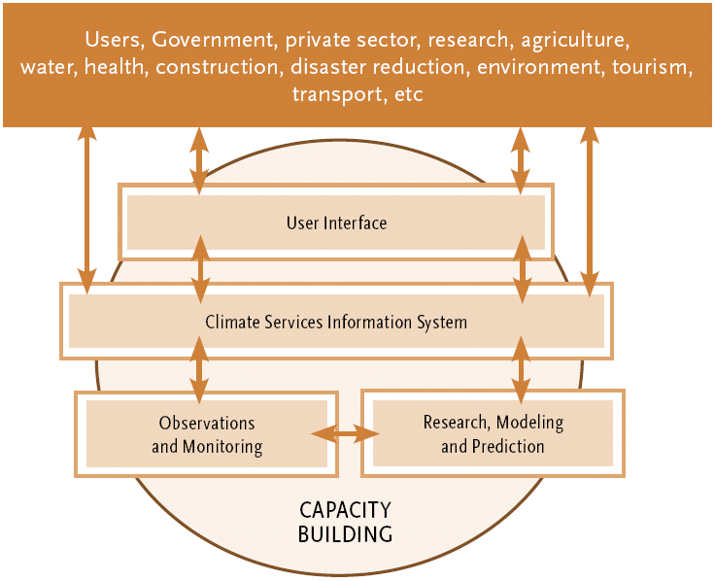
GFCS Pillars
Infrastructural Capacity Category
Global
Many countries lack the infrastructural, technical, human and institutional capacities to provide high-quality climate services.
Regional
National
Notes:
The GFCS has five main components or pillars whose implementation is critical to ensure that the entire value chain for the production and application of climate services is effectively addressed.
Obs and Monitoring
Many key regions and climatic zones remain poorly observed
Weakness in observational coverage of important oceanographic (ocean currents, mass flux, salinity, etc) and terrestrial parameters (ground water, permafrost, lake levels, etc.)
Lack of data on stream flow, irrigation requirements, crop yelds, etc.
Collection, standardization and access to socio-economic, biological and environmental data
Timely access to data in many locations
Data rescue

Slide 4
Implementation Strategies
Development of regional frameworks & support to Regional Climate Centres
Support to establishment of National Frameworks for Climate Services to coordinate and enable institutions to work together to co-design, co-produce, communicate, deliver and make use of Climate Services for decision-making in climate-sensitive socio-economic sectors & support to policy
Implementation of projects
  GFCS Adaptation Project in Africa (Malawi, Tanzania)
  Increased Resilience in Africa (Burkina Faso , Niger, Sénégal, ACMAD)
  Intra-ACP Programme
  Sustainability and Effectiveness of Climate Information Services

Slide 5
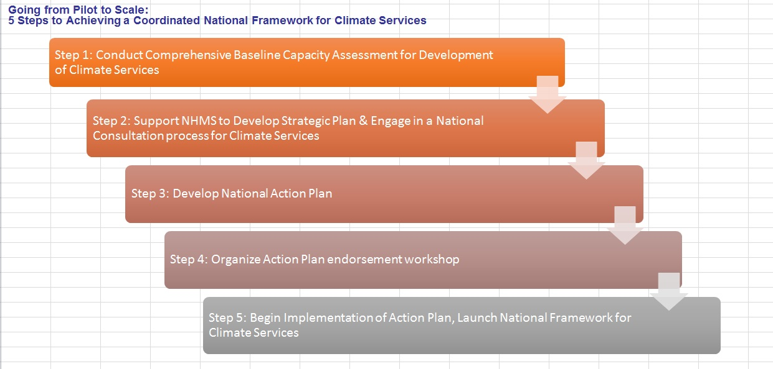
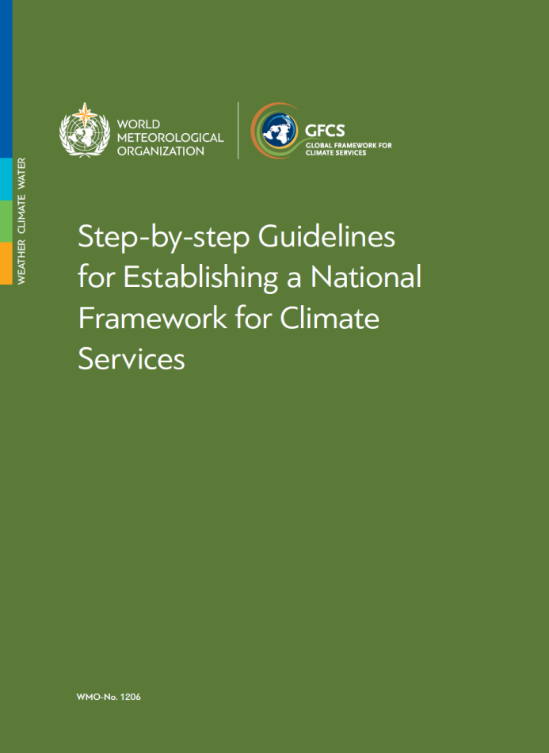
Step-by-step guidelines

Slide 6
Purpose of the guidebook
NMHSs and their partner institutions at national level engaged under the five pillars of the GFCS to establish a National Framework for Climate Services NFCS.
The National Frameworks for Climate Services aim to coordinate and enable institutions to work together to co-design, co-produce, communicate, deliver and make use of Climate Services for decision-making in climate-sensitive socio-economic sectors.
Notes:
National Meteorological and Hydrological Services (NMHSs) and other national institutions are free to use this Guide in its entirety, adapt it to unique circumstances in their countries or use the pieces that they find useful.

Slide 7
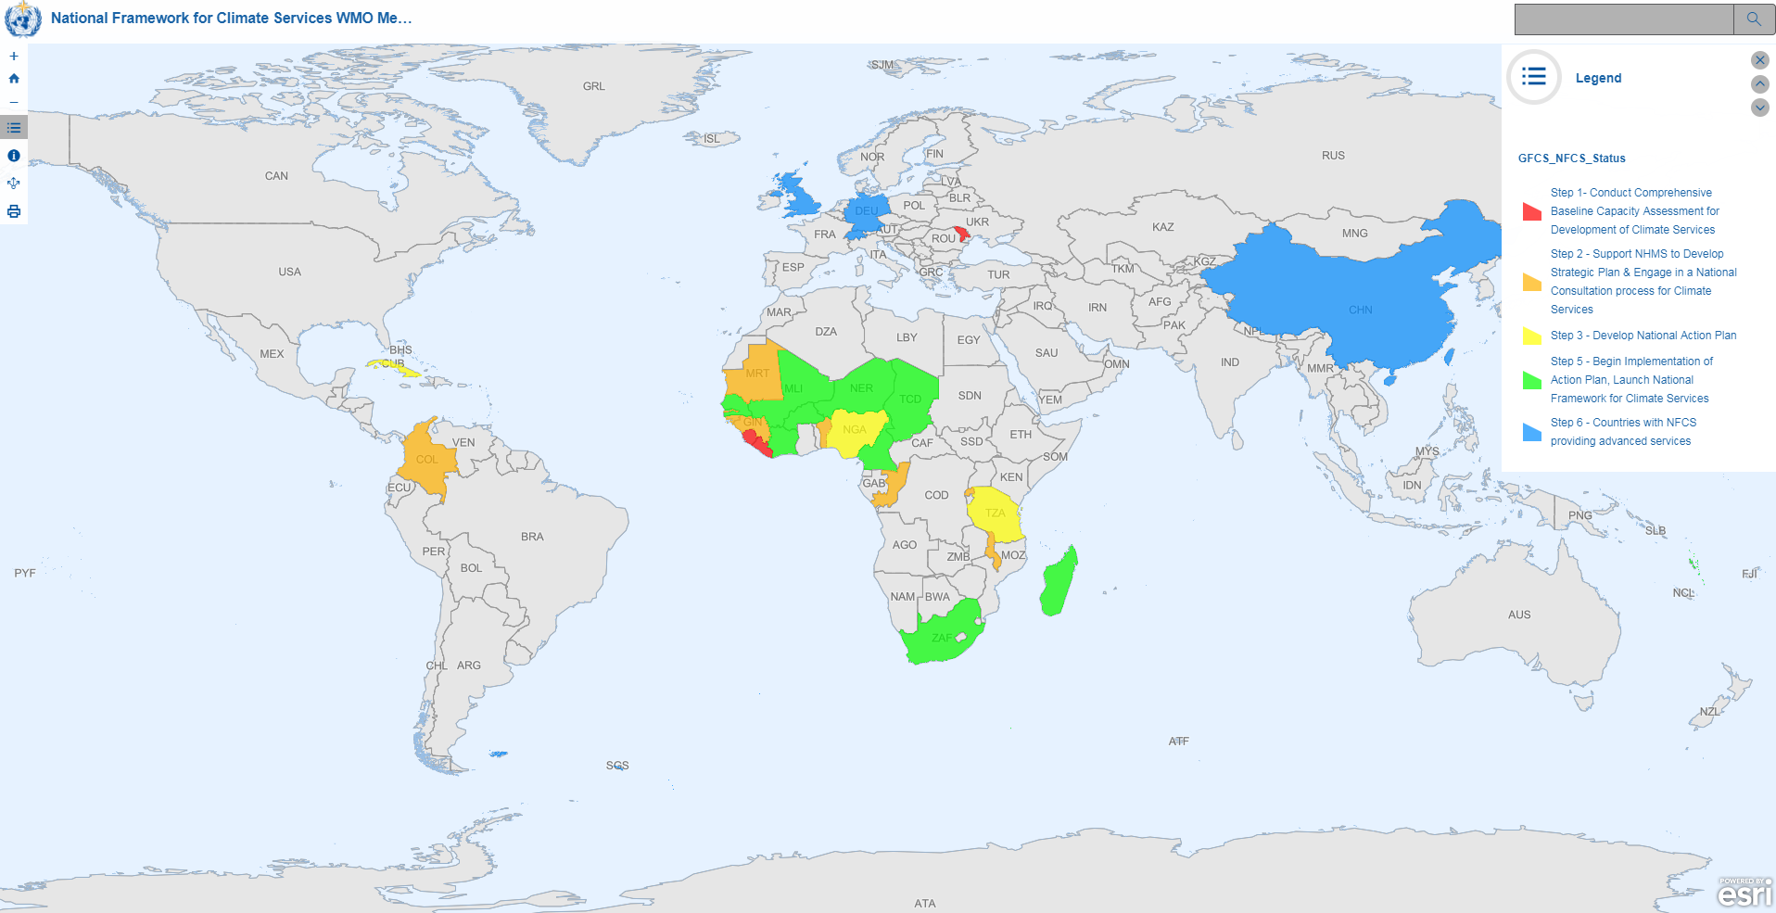
Status of NFCS
Notes:
National Meteorological and Hydrological Services (NMHSs) and other national institutions are free to use this Guide in its entirety, adapt it to unique circumstances in their countries or use the pieces that they find useful.

Slide 8
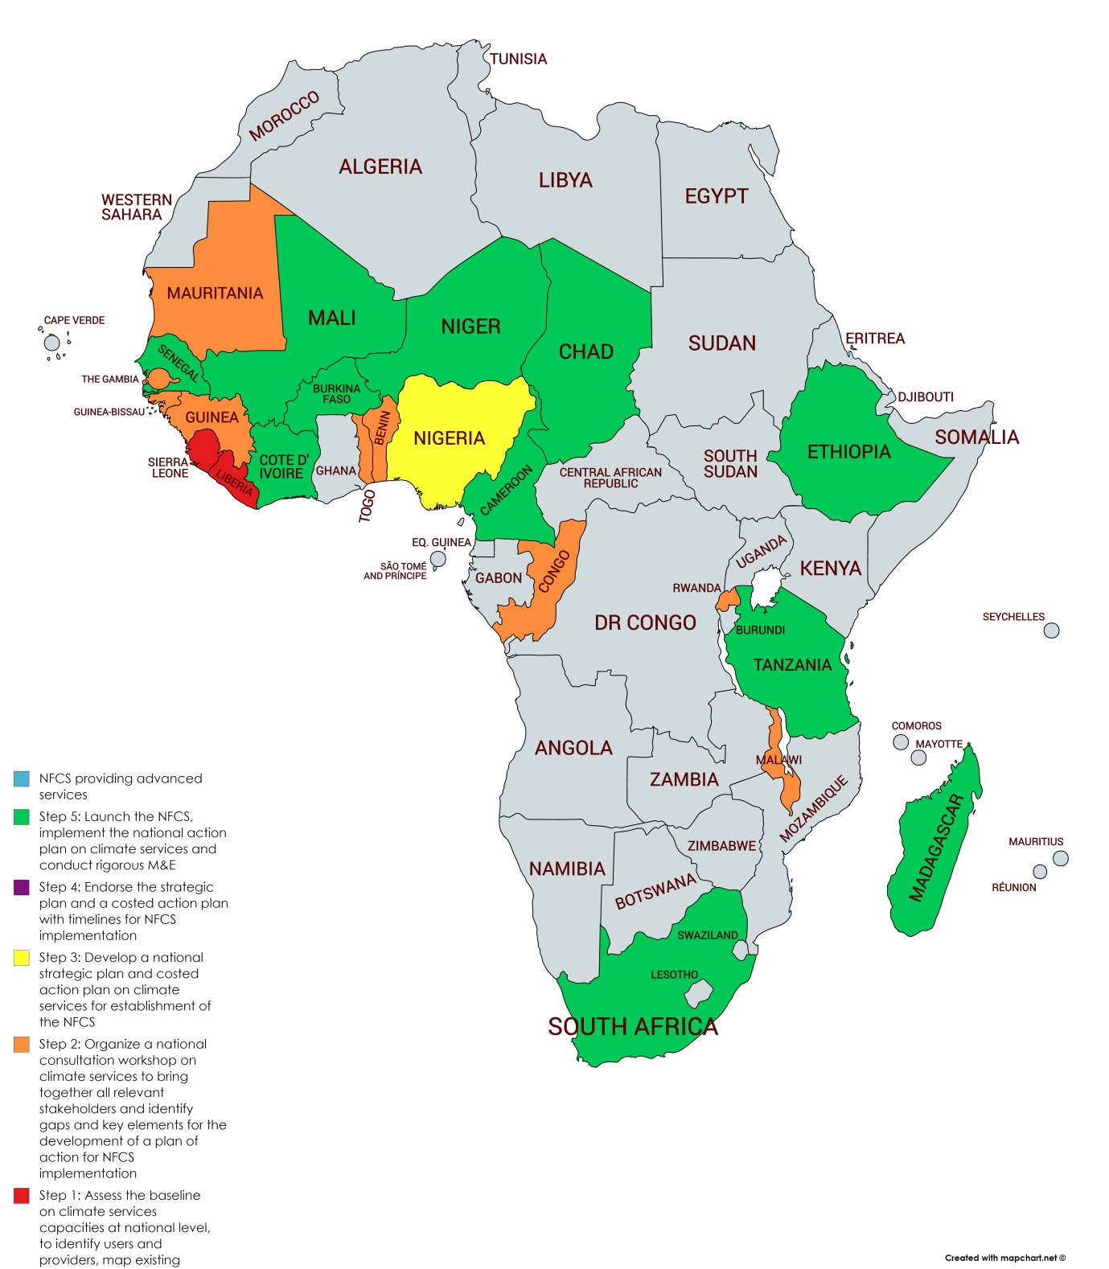
NFCS in Africa
Notes:
In Africa, NFCS are fully established in 11 and are at different stages of establishment in 12 further countries (see https://docs.google.com/spreadsheets/d/1AB_iPtoUC1grAASho1lI4CGiNbV_8ExS482hh89Ptsc/edit#gid=0).
Created on 16102018 using GFCS data (spreadsheet above), publication WMO-No. 1206 (2018), and https://mapchart.net/africa.html

Slide 9
Major needs
Tailored climate information products and advisory services;
Capacity development of professionals and communities on production and effective application of climate services;
Improved, standardized, and quality controlled sector monitoring data that is compatible with environmental and climate information;
Monitoring and evaluation of the appropriate, effective, and cost-effective use of climate information for sector decisions;
Research and prediction of sector impacts associated with climate variability and climate change, in collaboration with the climate research community;
Development and deployment of early warning systems appropriate to the sector and user communities;
Sustainable financial and technical support;
Better collaboration with the climate community for interdisciplinary policy, practice and research.
Notes:
Decision-makers do not often have access to information that would help them manage current and future risks. In many cases the knowledge exists but has not been converted into services that they can access and use.

Slide 10
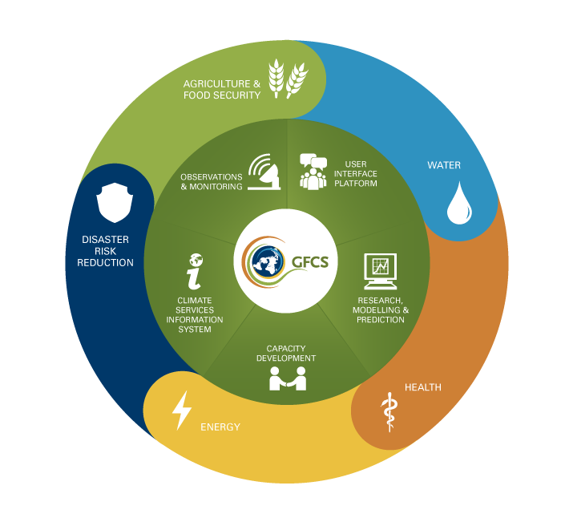

Slide 11

WMO Contributions to the Intra-ACP
Climate Services Project

Slide 12

Intra-ACP Climate Services Project
Project objective: Foster sustainable development
Indicator:
Progress towards SDG 13, Indicator 13.2.1:
  Number of ACP countries that have established or operationalized an integrated GHG reduction and climate change adaptation policy/strategy/plan in a way that does not threaten food production
Project outcome: Strengthen and improve the climate services value chain in ACP countries
Indicators:
Number of ACP Regional Climate Centers designated or in demonstration phase according to WMO standards
Number of final climate services value chain users as served by the action
  Disaggregated by gender, priority sector, ACP region/sub region

Slide 13
Intra-ACP Climate Services Project
Proposed budget by partner (in millions)
RECs/ Regional Org. | € 69.8
JRC | € 5.5
WMO | € 5.5
ACP | €3.4
DEVCO contract for evaluation and audits | € 0.8
Grand total - Intra-ACP Project Budget | € 85.0
Breakdown of RECs/RegOrg Budget (rounded to nearest million)
AUC | € 22 (-6 / -8 ACMAD)
CIMH | € 9
SPREP-SPC | € 9
ECOWAS | € 8
ECCAS
SADC | € 8
ACMAD
IOC | € 6
IGAD | € 8
Total budget, regional partners | € 70

Slide 14
Intra-ACP Climate Services Project
WMO Contributions to Project Outputs
Output 1
Output 2
Output 3
Output 4
User Interface Platform
Strengthening Climate Services Information Systems (CSIS)
Strengthening Observation and Monitoring
Enhancing Capacity
Structured interaction between the users, researchers and climate services providers in ACP regions through a User Interface Platforms
Provision of climate services (CS) at Regional and National level is effectively guaranteed and secured and CSIS are strengthened
Access to Climate Information is improved by strengthening observation and monitoring systems, as well as Research, Modelling and prediction
Capacity of ACP regions is enhanced to generate and apply climate information and products relevant to their particular concerns
Notes:
CSIS = operational core of GFCS process.
The production and distribution system for climate data and information products that address user needs.
Cube: front facet = flow of information; top and side show spatial and temporal dimensions for which info is collected and climate services are produced
The Climate Services Information System (CSIS) is the principal GFCS mechanism through which information about climate – past, present and future – is archived, analyzed, modeled, exchanged and processed.
The CSIS is the "operational core" of the GFCS. It produces and delivers authoritative climate information products through operational mechanisms, technical standards, communication and authentification.
Its functions include climate analysis and monitoring, assessment and attribution, prediction (monthly, seasonal, decadal) and projection (centennial scale). New infrastructure will be added to the CSIS currently in place to fulfill the GFCS vision.

Slide 15
Output 1
Structured interaction between the users, researchers and climate services providers in ACP regions through a User Interface Platform
WMO outputs - products/services
Activity
1.1
WMO- led
EUR 700,000
Overall coordination for the conception and development of the User Interface Platform.
The AUC, African RECs, CIMH, and SPREP establish/strengthen and promote the use of regional User Interface Platforms for selected priority sector(s).
The African RECs, CIMH, and SPREP establish/strengthen and promote the use of national User Interface Platforms (in 7 countries in total, one per sub-region) for selected priority sectors.
Guidelines for UIP / regional framework for CS
UIP helpdesk
CS needs assessment
Convene user fora/ working groups under GFCS priority areas
Establish NFCS
Provide forum for stakeholders on CS value chain production & application
Activity
1.2
WMO Co- led/ RECs-led
EUR 600,000
Activity
1.3
WMO Co- led/ RECs-led
EUR 700,000
Notes:
CSIS = operational core of GFCS process.
The production and distribution system for climate data and information products that address user needs.
Cube: front facet = flow of information; top and side show spatial and temporal dimensions for which info is collected and climate services are produced
The Climate Services Information System (CSIS) is the principal GFCS mechanism through which information about climate – past, present and future – is archived, analyzed, modeled, exchanged and processed.
The CSIS is the "operational core" of the GFCS. It produces and delivers authoritative climate information products through operational mechanisms, technical standards, communication and authentification.
Its functions include climate analysis and monitoring, assessment and attribution, prediction (monthly, seasonal, decadal) and projection (centennial scale). New infrastructure will be added to the CSIS currently in place to fulfill the GFCS vision.

Slide 16
Output 2
Provision of climate services at Regional and National level is effectively guaranteed and secured and Climate Service Information Systems (CSIS) are strengthened
WMO outputs - products/services
Activity
2.1
WMO Co- led/ RECs-led
EUR 200,000
Enhance RCC Capacities to produce, deliver and improve Climate Service, through Climate Service Information System (CSIS) at regional level.
Facilitate Implementation and Coordination of the Climate Services Information System (CSIS).
Establish and Improve Climate Data Management Systems (CDMS).
Development and Demonstration of a National Climate Services production chain.
Implementation plan for strengthening RCC
Regionally optimized objectives
Provide guidance to operationalize CSIS at global, regional & national scales
CDMS implementation
Activity
2.2
WMO Co- led/ JRC-led
EUR 400,000
Activity
2.4
WMO led
EUR 500,000
Activity
2.6
WMO Co- led/ RECs-led
EUR 500,000
Notes:
CSIS = operational core of GFCS process.
The production and distribution system for climate data and information products that address user needs.
Cube: front facet = flow of information; top and side show spatial and temporal dimensions for which info is collected and climate services are produced
The Climate Services Information System (CSIS) is the principal GFCS mechanism through which information about climate – past, present and future – is archived, analyzed, modeled, exchanged and processed.
The CSIS is the "operational core" of the GFCS. It produces and delivers authoritative climate information products through operational mechanisms, technical standards, communication and authentification.
Its functions include climate analysis and monitoring, assessment and attribution, prediction (monthly, seasonal, decadal) and projection (centennial scale). New infrastructure will be added to the CSIS currently in place to fulfill the GFCS vision.

Slide 17
Output 3
Access to Climate Information is improved by strengthening observation and monitoring systems, as well as Research, Modelling and prediction
WMO outputs - products/services
WMO Co- led/ RECs-led
EUR 200,000
Assess impact of existing gaps in climate observing networks on the produced climate services by this programme and invest in ground-infrastructure to improve such services.
Define and consolidate requirements for user driven services and provide feedback to international data providers for all 8 regions.
Review existing observing system against CS needs & GCOS/WICOS requirements
Provide support and oversee procurement & installation
Identify gaps and requirements in tailored services
Activity
3.1
Activity
3.3
WMO Co- led/ JRC-led
EUR 200,000
Notes:
CSIS = operational core of GFCS process.
The production and distribution system for climate data and information products that address user needs.
Cube: front facet = flow of information; top and side show spatial and temporal dimensions for which info is collected and climate services are produced
The Climate Services Information System (CSIS) is the principal GFCS mechanism through which information about climate – past, present and future – is archived, analyzed, modeled, exchanged and processed.
The CSIS is the "operational core" of the GFCS. It produces and delivers authoritative climate information products through operational mechanisms, technical standards, communication and authentification.
Its functions include climate analysis and monitoring, assessment and attribution, prediction (monthly, seasonal, decadal) and projection (centennial scale). New infrastructure will be added to the CSIS currently in place to fulfill the GFCS vision.

Slide 18
Output 3, ctd…
Access to Climate Information is improved by strengthening observation and monitoring systems, as well as Research, Modelling and prediction
WMO outputs - products/services
Activity
3.4
WMO Co- led/ RECs-led
EUR 300,000
Ensure RCCs have operational access to existing climate information produced at national level through NMHSs, including data rescue (recovery and digitalization)
Provide methods and tools for observational datasets and model inter-comparison at the regional scale to RCCs to assess which datasets are fit-for-purpose for their regions.
Regional climate assessment and Data Set System
Regional customization of the CS toolkit
Activity
3.5
WMO Co- led/ RECs-led
EUR 200,000
Notes:
CSIS = operational core of GFCS process.
The production and distribution system for climate data and information products that address user needs.
Cube: front facet = flow of information; top and side show spatial and temporal dimensions for which info is collected and climate services are produced
The Climate Services Information System (CSIS) is the principal GFCS mechanism through which information about climate – past, present and future – is archived, analyzed, modeled, exchanged and processed.
The CSIS is the "operational core" of the GFCS. It produces and delivers authoritative climate information products through operational mechanisms, technical standards, communication and authentification.
Its functions include climate analysis and monitoring, assessment and attribution, prediction (monthly, seasonal, decadal) and projection (centennial scale). New infrastructure will be added to the CSIS currently in place to fulfill the GFCS vision.

Slide 19
Output 4
Capacity of ACP regions is enhanced to generate and apply climate information and products relevant to their particular concerns
WMO outputs - products/services
Activity
4.2
WMO Co- led/ ACP-led
EUR 800,000
Organize Intra-ACP Climate Services ACP yearly for a
Set up a dedicated Information platform/Portal to exchange best practice, make information available for specific need and encourage cooperation between the regions.
Support ACP Secretariat in developing content for the yearly For a and publication of findings
Support ACP Secretariat in the development of the information portal to ensure maximum visibility and usefulness to relevant stakeholders in the ACP regions
Activity
4.3
WMO Co- led/ ACP-led
EUR 200,000
Total budget allocated to WMO through the Intra-ACP Climate Services Project
= EUR 5,500,000
Notes:
CSIS = operational core of GFCS process.
The production and distribution system for climate data and information products that address user needs.
Cube: front facet = flow of information; top and side show spatial and temporal dimensions for which info is collected and climate services are produced
The Climate Services Information System (CSIS) is the principal GFCS mechanism through which information about climate – past, present and future – is archived, analyzed, modeled, exchanged and processed.
The CSIS is the "operational core" of the GFCS. It produces and delivers authoritative climate information products through operational mechanisms, technical standards, communication and authentification.
Its functions include climate analysis and monitoring, assessment and attribution, prediction (monthly, seasonal, decadal) and projection (centennial scale). New infrastructure will be added to the CSIS currently in place to fulfill the GFCS vision.

Slide 20
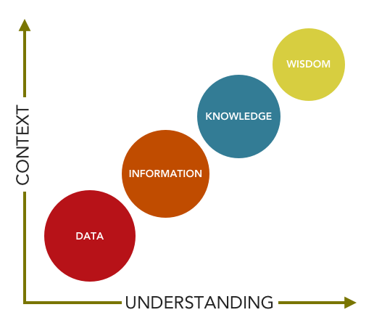
Data or information?
Notes:
People often need information and not data. Data are requested when information is unavailable.

Slide 21

Thank you
Merci
Gracias
Obrigado
contact: flucio@wmo.int

