Slide 1
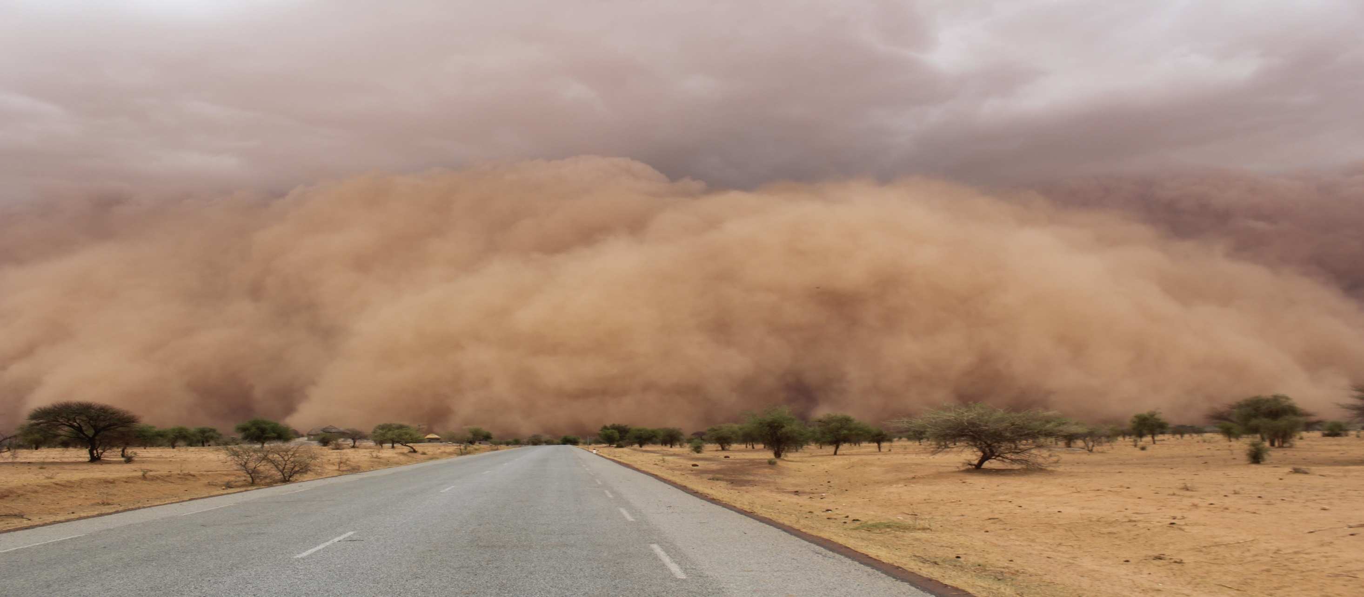

UNDP’s Support for Climate Adaption in Africa:
A New Approach to Climate Information Systems
Multi Country Programme for Climate Information for Resilient Development and Adaptation in Africa (UNDP- CIRDA)
ECCAS Hydromet Forum
On behalf of
Dr. Bonizella Biagini, UNDP CIRDA Programme Manager
14 - 16 November 2018
Libreville, Gabon
Notes:
This is the picture of the Squall Line that Ulrich took from Burkina Faso. It is pretty cool, and very poignant in terms of climate realities that our countries are facing

Slide 2

Outline
  Importance of Climate Information and concrete adaptation actions
  Technology & communication gaps – views from the field
  A new vision to find pragmatic solutions
  Bringing in the private sector
  The last mile
  Lessons Learned

Slide 3
Information for Adaptation
UNDP approach to climate information in Africa has been designed in response to African LDCs’ recognition that adaptation can not be achieved without reliable climate and weather information
    Lack of actionable weather and climate information is a major cause of low adaptive capacity in Africa
    Information must be accurate, comprehensive, timely, and consistently maintained (sustainable)
    Information must be communicated and tailored to end users (policy makers, communities, etc.)
Availability of Synop reports received at MTNCs from RBSNs
Monitoring activities coordinated by WMO Secretariat
Notes:
This slide supports the basis for CIRDA: to fill a major gap in adaptation planning as recognized by the LDCs themselves (country driven). The slide also shows the lack of coverage in LDCs and some middle income countries (Africa of course, SIDS, Africa, China) vs the extensive amount of WMO compliant stations reporting in developed economies (look at US, Europe, Australia). Also, such data as is being collected in Africa has traditionally too often been for global climate modeling (i.e. WMO) but does not have the geographic coverage, content, or communication required for providing early alerts. The last bullet also allows us to begin to introduce the concept of the last mile.

Slide 4
UNDP Programme for Climate Information and Resilient Development in Africa (CIRDA)
Support
    Data and tech transfer, digitization
    Identify and reach end users
    Mainstream/integrate data into development planning (NAPs)
    Financial sustainability planning/PPP partnerships
11 Partner countries.
Burkina
Faso
The Gambia
Ethiopia
Objectives
    Support climate services (NHMS) in their efforts to collect, analyse and disseminate climate information for long term planning and adaptation
    Provide timely, high quality climate information to reach across the last mile
    Enable policy makers and vulnerable communities to make informed decisions
    Save lives and livelihoods
Sierra Leone
Liberia
Benin
Uganda
São
Tomé
Tanzania
and
Príncipe
Zambia
Malawi

Slide 5
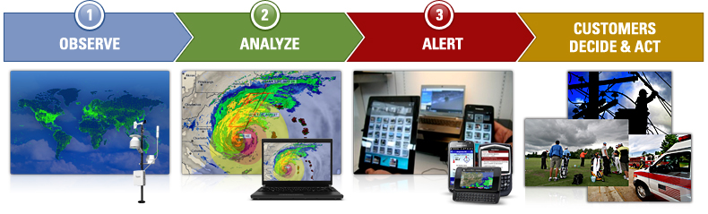
The CIRDA Approach
An end to end approach allows for all steps in an EW and CI Systems to work seamlessly and efficiently for informed decision making.
Notes:
Image from http://info.publicintelligence.net/WIFA_Project_Outline_Executive_Summary.pdf

Slide 6
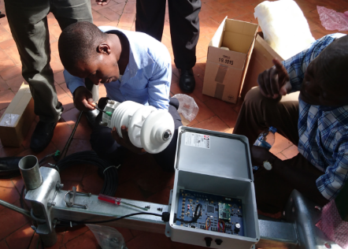
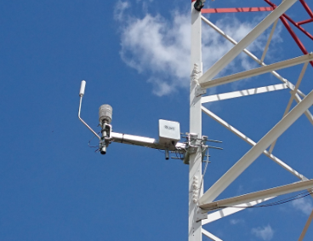
A new possibility for climate services
  New and more cost efficient technologies can provided high quality climate and weather observations and leverage mobile communications networks
Integrated Lightning sensor with all in one AWS
Temp / Humidity
Pressure
Wind Speed / Dir
Solar radiation
Separate Automatic Rain-gauge
Images from the site installation in Uganda: Sensors were installed on Mobile Telecommunications towers, guaranteed power, security an communications
Notes:
The image shows the basic components of the AWS system that is mounted on the cell tower. The installation process can take up to 3 hours with good experience to complete. The standard AWS installation takes up to 3 days min to complete.
While there have been concerns regarding the data quality from the sensors and whether they will be affected by the towers and the placement of the sensors above ground (all at 10m), these issues have been addressed by research and will be further validated in the CIRDA program. The meso-scale network is operational at over 8000 locations globally.
See station density in weather Philippines application http://weather.com.ph//

Slide 7
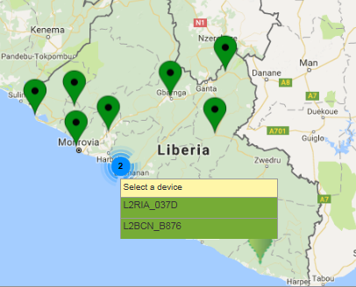
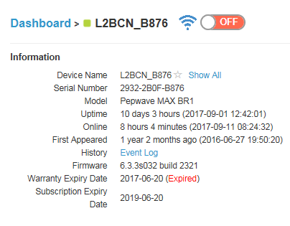
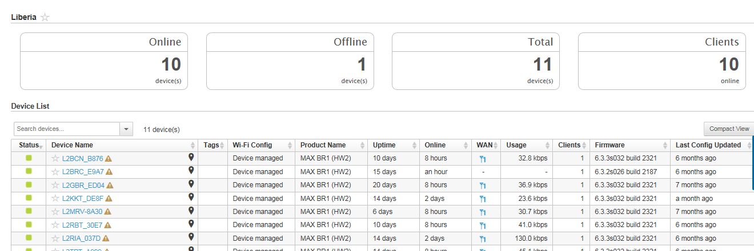
Converting observations to information in real time on cloud platforms
  Data and information can be easily shared via the cloud, opening up the possibility for product development
Real Time Network view (Liberia)
Real Time Product view (Sierra Leone)
Notes:
Cellular networks are expanding and are a good way to reach the last mile as the information can be easily tailored. The real time product views show processed model output data, combine with lightning and proxy radar (derived from lightning data). All the products can be made available as ‘building blocks” that can be ingested into third party systems i.e. national weather service websites, commercial website portals. In the case of Uganda, UNMA has authorized a trial of data to be submitted to the HNI 3 2 1 service .

Slide 8
Moving towards integrated water resources management
  Cloud-based software solutions that:
  Merge data from different hydrological and meteorological observation systems (automatic & manual)
  Inclusion of satellite products reduces reliance on in-situ observation systems (O&M)
    satellite altimetry for river level monitoring
    satellite derived soil moisture and evapotranspiration mapping
  Hydrological early warnings
    Agricultural droughts, Hydrological droughts, Riverine flooding
  Water allocation planning module
  Visualization, information sharing (API)
Notes:
Cellular networks are expanding and are a good way to reach the last mile as the information can be easily tailored. The real time product views show processed model output data, combine with lightning and proxy radar (derived from lightning data). All the products can be made available as ‘building blocks” that can be ingested into third party systems i.e. national weather service websites, commercial website portals. In the case of Uganda, UNMA has authorized a trial of data to be submitted to the HNI 3 2 1 service .

Slide 9

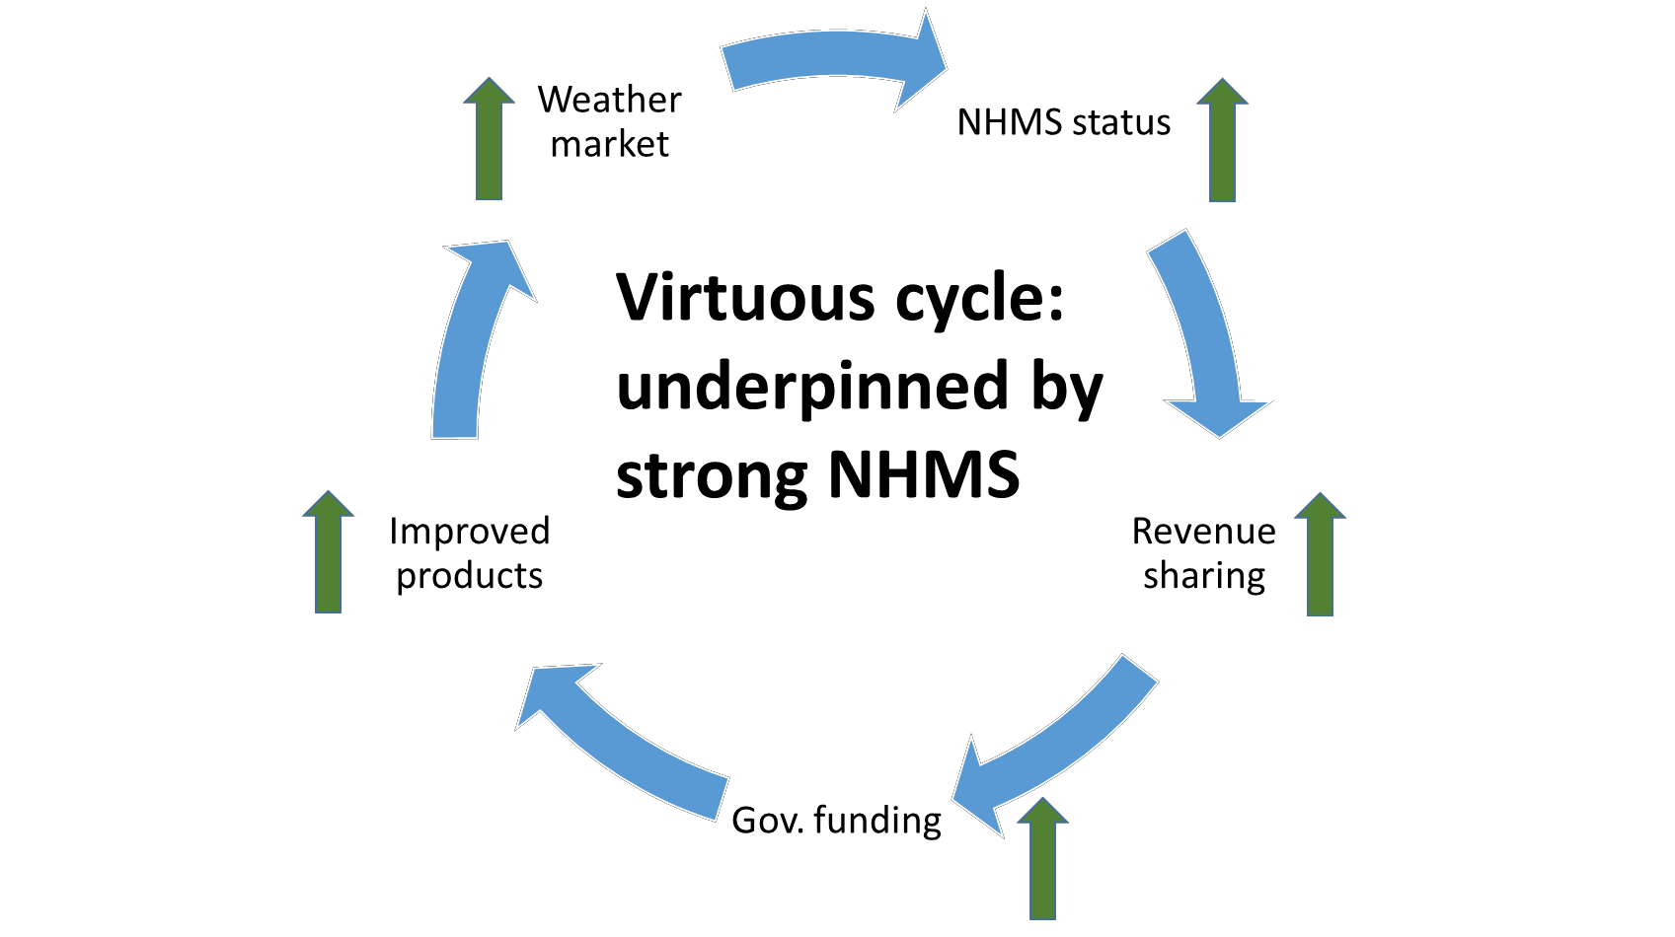
Supporting system sustainability through public private partnerships
Financial and operational sustainability is a major challenge to the delivery of CI and EWS -- particularly to the poorest and most vulnerable. Partnerships with private weather companies can help.
Private providers of weather observation/forecasting/ communication -- growing market reality.
Public use of private weather services is accepted practice outside Africa
Multiple companies offer support to NHMSs and services to vulnerable populations – while preserving Met Service role and authority
Revenue sharing opportunities from tailored weather services (eg aviation,
agriculture, etc.) can support NHMSs
Partnerships will contribute more broadly to sustainable development goals and ensure long term sustainability.

Slide 10
Last Mile support
  Reaching users with information that is accessible, actionable and relevant
  HNI 3-2-1 service in Malawi
  First steps into PPP climate information marketing efforts in Liberia, Sierra Leone, Uganda
  Workshops on private sector development, PPP’s, joint product development
  Market studies to assess potential
  Engagements with mobile providers

Slide 11
Lessons Learned in Project Implementation
Train the decision-makers and administration staff, the private sector, and in particular, staff responsible for disaster management, in assimilating and using Alerts (Early Warning), meteorological and climate forecasts,
Setup an Inter-institutional and Multi-Disciplinary Committee to promote Synergy, resolve coordination problem and promote data sharing between the organizations and the related EWS initiatives and research Centers,
Create an open access EWS portal for data sharing across sectors, specifically by facilitating access to the Internet and mobile services through a public-private partnership (PPP),
Comprehensively assess the needs for climate services and products in the private sectors and sign public-private partnership agreements with the companies operating in the mining, farming, horticulture, fisheries and pastoral sectors,
Sustainability of project could also be achieved by maintaining the stability of trained staff in the institutions concerned.
Notes:
Programs should focus on providing procurement guidance that considers end to end approaches from the onset
Programs need to bring more stakeholders to the table and help countries link needs with potential services (bring in the private sector) and help them clear hurdles for PPPs
Programs should provide guidance on how to make information accessible for software developers and last mile services

Slide 12
Thank you
www.adaptation-undp/projects/cirda
www.undp-cirda.blogspot.com
Twitter @bonizella
Notes:
Programs should focus on providing procurement guidance that considers end to end approaches from the onset
Programs need to bring more stakeholders to the table and help countries link needs with potential services (bring in the private sector) and help them clear hurdles for PPPs
Programs should provide guidance on how to make information accessible for software developers and last mile services

