Slide 1

Status and challenges of meteorological and hydrological services in Central Africa

Slide 2
Introduction
The majority of livelihoods in ECCAS depends on environmental resources. However, climate-related extremes such as drought, dry spells, floods, dust and sand storms, lightning strikes, windstorms, desertification, etc. frequently impact the communities leading to loss of lives, livelihoods and property. Hence the need for strong, responsive, state-of-the-art weather, climate & water services institutions

Slide 3
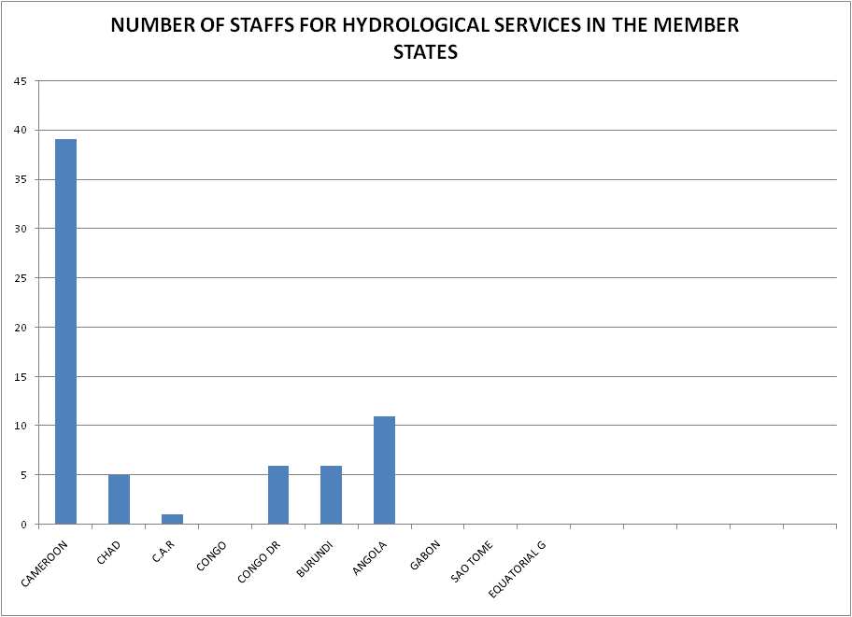
Human Capacity
NMS are poorly staffed, especially with personnel with advanced skills (forecasters, researchers, etc.)
Close to 40% of NMS staff are over 50 years.
Good number of middle aged staff in CAR, DR Congo, Burundi, Gabon
National Hydrological Services are generally under staffed, Cameroon has the highest number of 39, Angola with 11, with some countries operating with non-professionals in hydrology!

Slide 4
Capabilities of ECCAS NMHSs
The capabilities of NMHSs in ECCAS is close to Category 2 – ‘Essential’ services (basic, essential, full, advanced)
taking observations
data management
interaction with users
medium range forecast and warnings
established links with media and DRR communities
seasonal climate outlooks
climate monitoring
hydrological data products for design and operation of water supply structures
water level & flow monitoring
short-term flow forecast
flood forecasting, etc.

Slide 5
Challenges
Density of weather observing networks is below WMO standard in all except Sao Tome and Principe (size of country) and Equatorial Guinea (not a Member of WMO). Significant number of existing stations are ‘silent’ and do not contribute to the World Weather Watch (global public good). This impacts on the quality of forecasts around the world and in the ECCAS region.
Very few NHSs possess the capacity to use flood hazard, exposure and vulnerability information in the country to carry out risk assessment at national, provincial and local levels.

Slide 6
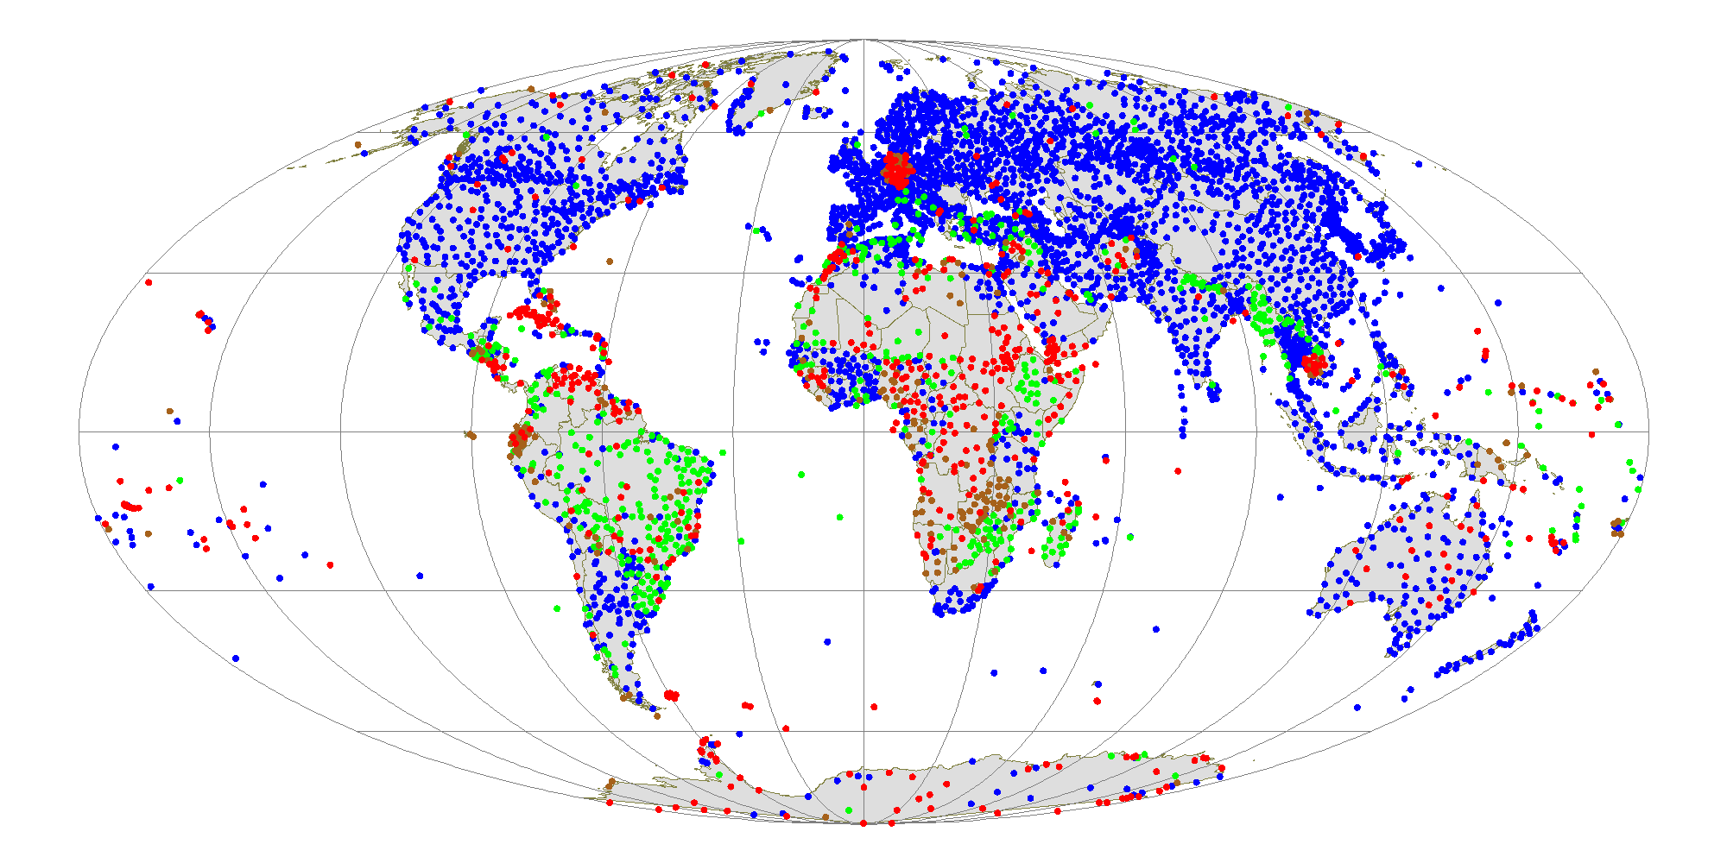
Synop reports availability
Blue: 90% - 100%
Green: 45% - 90%
Brown: 1% – 45%
Red: Silent station

Slide 7
Challenges
NMHSs depend on Government budgetary allocations, thus leading to insufficient funding for standard operations, equipment purchase and staff recruitment.
Partnership between NMHSs and other public sectors, and with private sector weather services providers is at its infancy and needs trust-building.
Some external interventions in the hydromet sector do not involve local NMHSs, thus undermining skills enhancement, sustainability, etc.
Skills in management of NMHSs need to be enhanced for greater productivity
User-community does not engage with NMHSs sufficiently (e.g., design of projects, feedback on services, sharing the burden, etc.)

Slide 8
Opportunities
AMCOMET resolution for the transformation of NMHSs to semi-autonomous agencies. However, the most of the new semi-autonomous NMHSs require support for ‘take-off’ and be able to implement their mandate effectively.
NMHSs are Members of their National Platform for Disaster Risk Management, albeit somewhat limited contributions, due to low capacity and capabilities.
NMHSs have access to regional quantitative subseasonal or seasonal climate and hydrological forecasts. However, accessibility and uptake of the information by local communities need significant improvement.

Slide 9
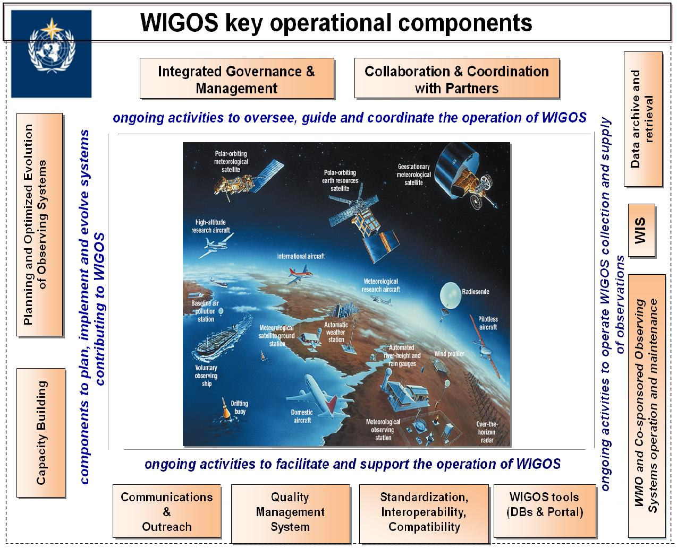
Opportunities
WMO Integrated Global Observing System (WIGOS) calls for collaboration between sectors taking measurements of the essential climate variables (atmospheric, oceanic, terrestrial systems) – benefits include partnership building between NMHS and other actors, increased spatial coverage, cost-effectiveness, etc.

Slide 10
Conclusion
NMHSs in ECCAS need significant strengthening to serve local communities and contribute to the global public good
ECCAS – RCC needs to be operational in order to contribute to coordinate hydromet interventions in the region
ECCAS Secretariat needs to position itself well in order to benefit fully from global initiatives such as the WMO Reform, Alliance for Hydromet between WMO and the World Bank, EU-ACP GFCS project, etc.

Slide 11

Thank you
Merci

Slide 12
Opportunities
WMO/AMCOMET support for the preparation of National Strategic Plans for NMHSs (Burundi, Central African Republic, …..)
Climate Risk Early Warning System (CREWS) / WB in DR Congo with scope to widen interventions
WMO supported the feasibility study for the establishment of the ECCAS Climate Centre (CAPC-AC)
WMO/NORCAP supporting the launching of NFCS

Slide 13
Categorization of NMHSs
Level of service | Weather services | Climate services | Hydrology services | Description of capacity needed to achieve service level
Category 1 Basic | Weather observations Weather data management Interaction with users of weather and products | Climate observations Climate data management Interaction with users of climate data and product | Hydrological observations Hydrological data management Interaction with users of hydrological data and products | Small network of quality-controlled observations Basic data processing, archiving and communication systems Little or no backup/offsite storage or contingency options Staff: observers and some meteorologists trained to the standards described in the basic introduction Package (BIP) No 24/7 operation Rudimentary quality management system No research and development
Category 2 Essential | Medium-range (synoptic scale) forecast and warnings Established links with media and disaster risk reduction (DRR) communities | Seasonal Climate Outlooks Climate monitoring | Hydrological data products for design and operation of water supply structures Water level and flow monitoring Short-term flow forecasts (low flows) Flood forecasting | Able to take and integrate observations from other parties Well-established protocols for emergencies, backup of data and minimum offsite facilities Staff: observers and meteorologists trained to BIP standards 24/7 operation Well-established quality management system Able to access most numerical weather prediction data/products from other centres Small research and development unit Some partnerships as junior member
Category 3 Full | Specialised weather products for wide range of sectors Well integrated into DRR communities and having mature links with the media | Specialized climate products Decadal Climate prediction Long-term climate projections | Seasonal stream flow outlooks Specialized hydrology products | Advanced observation equipment. Ability to run its own numerical weather prediction suit Research and development unit Well-educated/trained staff Own training group Developed library and information services Active partnerships with NMHSs taking a leading role
Category 4 Advanced | Customized weather products Weather application tools | Customized climate products Climate application tools | Customized hydrology products Hydrology application tools | Advanced observations Leading research and development team Well-developed education and training unit

