Slide 1
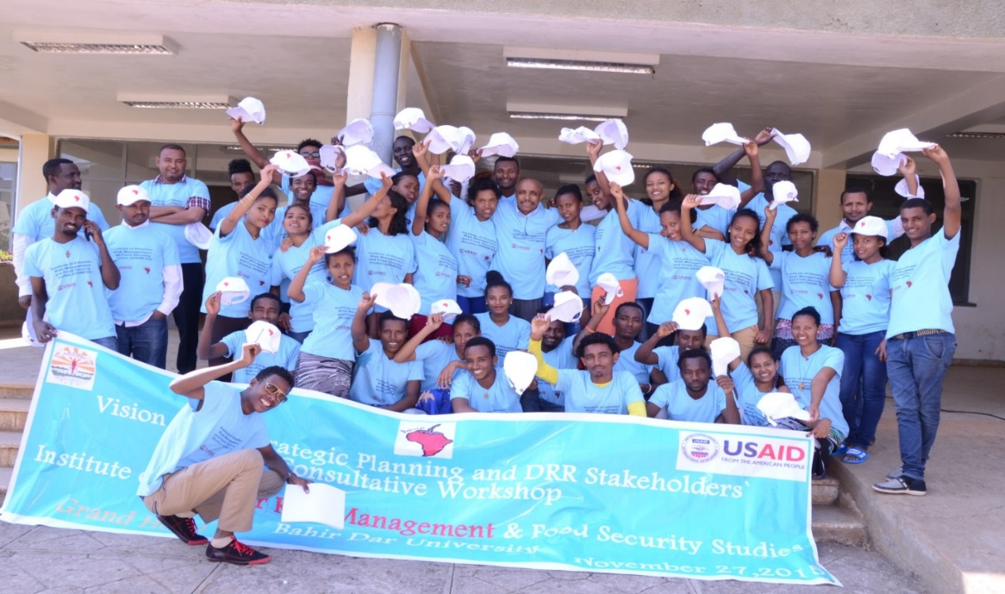


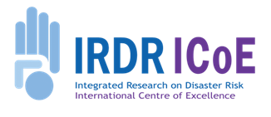
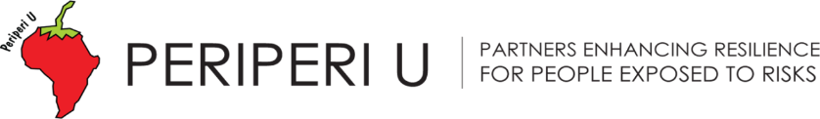
Fast-tracking Resilience Capabilities in Africa
Periperi U – making it happen
November 2018
Professor Sam Ayonghe, University of Buea
ayonghesn@gmail.com

Slide 2
Two major shifts in DRM-related policy/practice and Africa’s higher education enterprise.
In the past, policy, practice & the academic enterprise separated disasters & development.
They also separated DRM policy/practice from Africa’s science & higher ed. enterprise.
These distinctions are long-gone, with:
Risk & resilience now “front & centre” of development, &;
Urgency for new forms of ‘future-ready’ capabilities and skills in Africa.

Slide 3
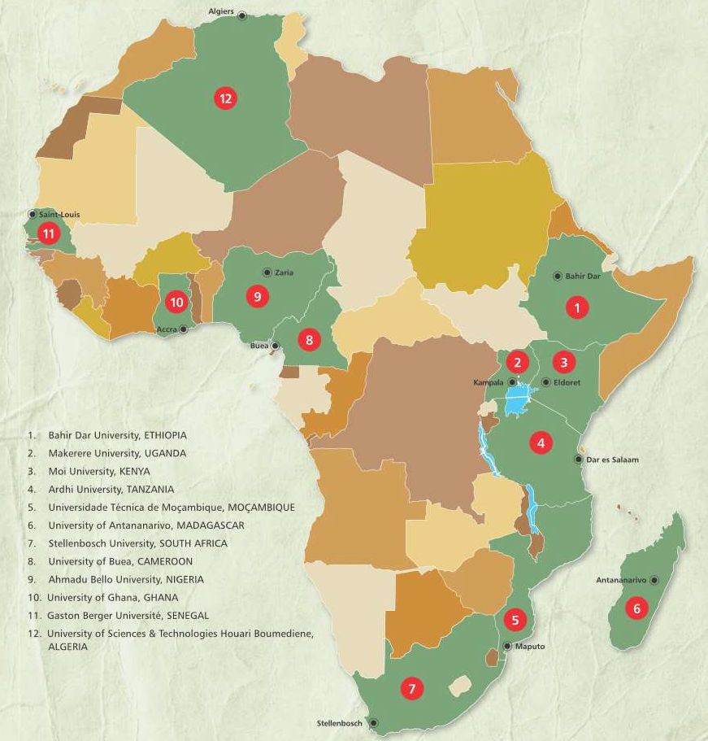
This was the forward-thinking behind Periperi U
Conceptualised in early 2000s
& built a mature univ. architecture for disaster risk and resilience capacity building in Africa.
Expertise in DR curricula integration across multiple disciplines & practice fields.
Also, a mechanism for integrating climate risk mgmt with DRM.
.

Slide 4
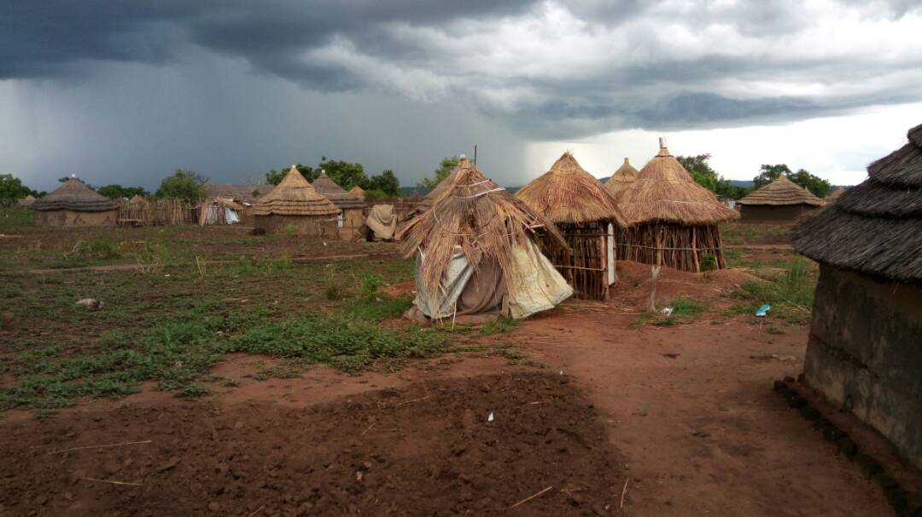
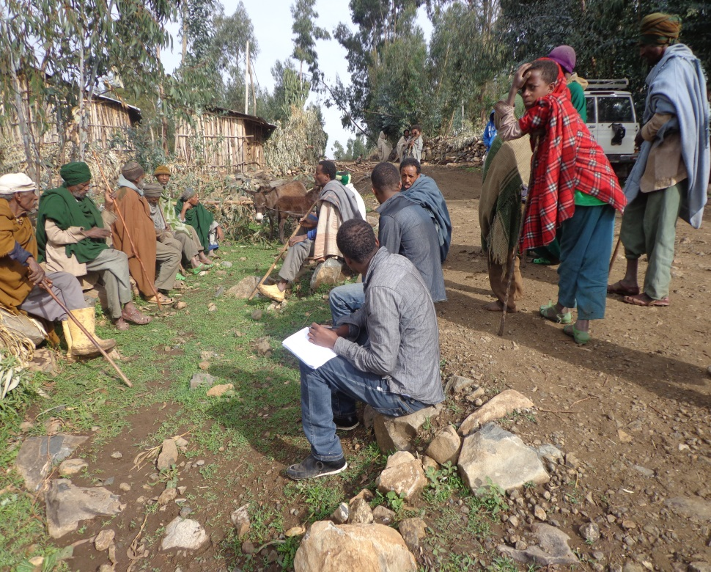
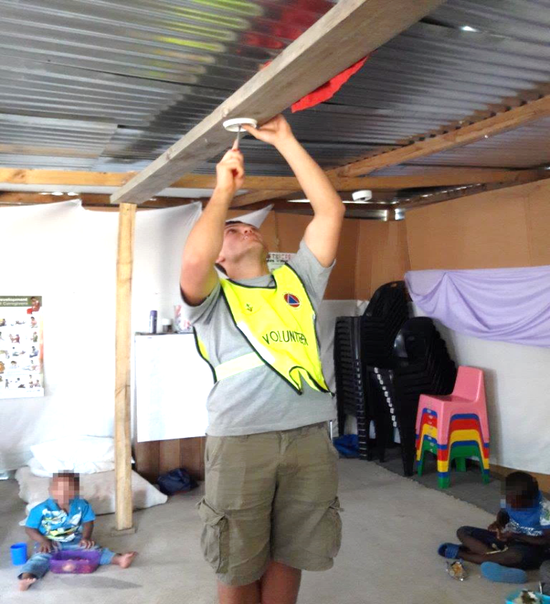
A Transboundary Partnership of African HEIs
12 univs, 200 staff, eight languages
44 DR-related academic progs & modules since 2005
+/- 2 000 students registered in 2018
87 short courses that reached 2,400 people (2011/16)
Commitment to socially responsive DR scholarship.

Slide 5
Periperi U is not a ‘typical’ academic network.
But a ‘virtual Pan-African centre’ that embeds itself in local risk contexts & works in close, practical partnerships with government and other stake-holders …
… across local to subnational, national, regional, continental and international levels.
Our members carry out five-inter-linked areas of work – that are mutually reinforcing and keep us grounded in reality.

Slide 6








Enhancing disaster preparedness & BBB
Investing in DRR for Resilience
Academic Programmes
Integrated
Disaster Risk
Research
Practitioner
Training
Strengthening disaster risk governance
Community Outreach
Strategic
Engagement
Understanding disaster risk

Slide 7
It has pioneered a diverse suite of risk-related degree progs & short courses that are ‘fit-for-purpose’…eg
MSc DRM & Sust. Dev. (Bahir Dar, Ethiopia).
MSc Prevention & Management Food Insecurity Risk (Gaston Berger Univ, Senegal)
Masters Public Health Disaster Management (Makerere Univ., Uganda)
MPhil Management of Disasters and Risks (Tanà, Madagascar), and now …
MSc DRM & Safety (UBuea, Cameroon).

Slide 8
So what? Tracer study of graduates for lagged effect of investment in skilled human capital
Univ. | Dis. Risk-Related Degree |  | Male | Female | Tot.
Ardhi | M (DRM) |  | 21 | 11 | 32
Ardhi | MSc (DRM) |  | 12 | 13 | 25
BDU | MSc DRM & SD |  | 101 | 20 | 121
Mak. | MDM |  | 6 | 4 | 10
Tanà | MPhil Multidiscip. DRM |  | 70 | 35 | 105
UDM | MSc Tech. Ed, Dev & DM |  | 9 | 6 | 15
Subtotal: Pgrad |  |  | 219 | 89 | 308
UDM |  | BSc Env. Eng. and DM | 45 | 90 | 135
Total |  |  | 264 | 179 | 443

Slide 9
Madagascar: Univ. of Antananarivo (105 MPhil DRM grads)
 | M | F | Total
Government | 39 | 17 | 56
Private sector | 13 | 6 | 19
IO/(I)NGO | 7 | 7 | 14
Educ ⁄ Acad. | 6 | 3 | 9
Unemployed | 2 | 2 | 4
Unknown | 2 | 1 | 3
 | 69 | 36 | 105
56% grads in Disaster/Risk Mgmt or Civil Protection-related services.
53% grads employed in govt

Slide 10
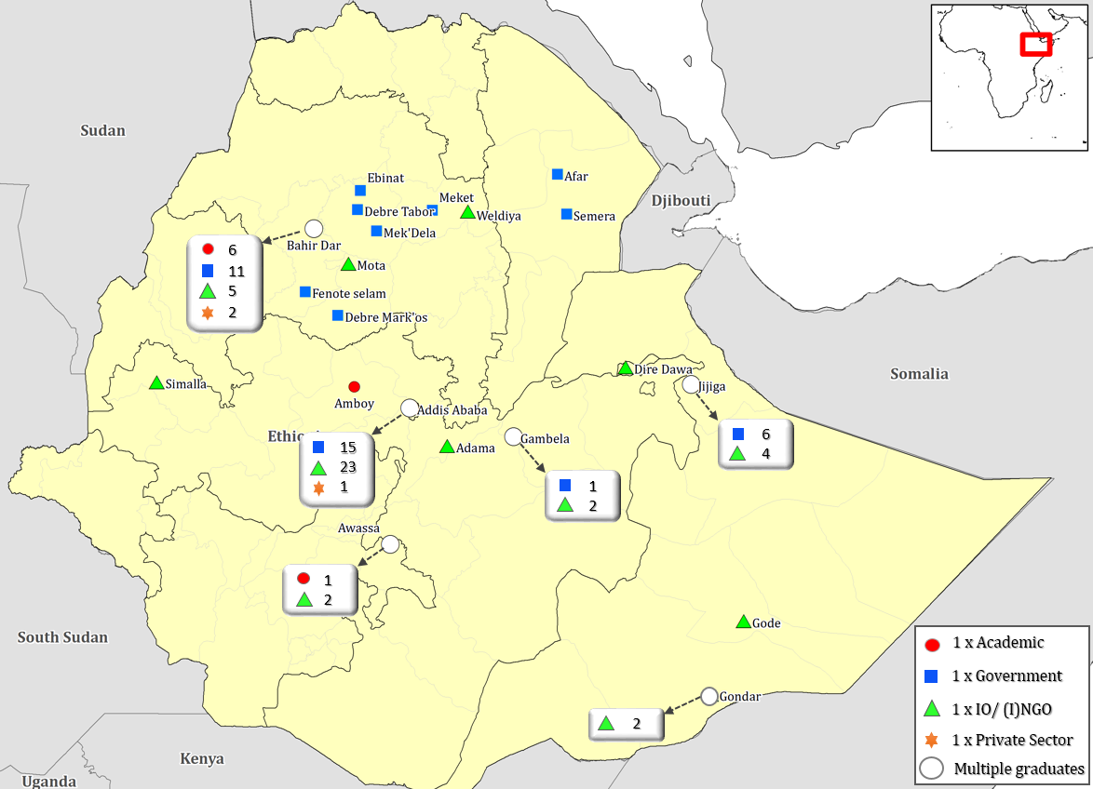
 | Total | %
(I)NGO | 45 | 45.5
Govt | 42 | 42.4
Educ/Acad. | 9 | 9.1
Pvt sect. | 3 | 3.0
Unemp. | 0
Unk. | 22
Total | 121
Ethiopia: Bahir Dar Univ. (99 MSc DRM +SD grads)
Geographic distrib. MSc DRM & Sustainable Dev. grads
61 % in sub-national or ocal positions.
42% in govt positions
9% academic posts
46% in IOs &(I)NGOs

Slide 11
We can leverage this architecture and skilled teaching staff to fast-track DRM capacity at REC and continental level:
Inaugural Africa Risk Methods School (ARMS) 10-23 September, 2018

Slide 12

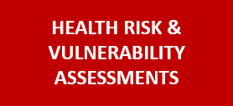

Ardhi Univ, Tanzania
‘Adventurous’, innovative collaboration (UNDP, WHO, six Periperi U univs, SU’s African Doctoral Academy)
Univ Gaston Berger, Senegal
(February, 2019) Similar format, includes food security assessment.
POST DISASTER NEEDS ASSESSMENT
http://www.riskreductionafrica.org/events/periperi-u-risk-methods-school.html

Slide 13
Periperi U Insights on Reducing Risk and Resilience Building
Fast-tracking skilled DRM & othresilience capabilities are development imperatives in ECCAS & beyond.
They are critical skill-sets for African countries that face recurrent threats & capacity challenges.
- Because they build in institutional agility to expand capability under conditions of duress.
Periperi U has demonstrated both how to:
  fast-track these skill-sets and
  scale this continent-wide – with IMPACT.

Slide 14
To conclude,
PPU is strengthening the synergies between the hydromet services and DRM in ECCAS.
It is implementing architecture that reaches across govt, and down to communities through skilled capacity that will enable the DRM architecture to make a protective difference.
The CC domain (or Hydromet domain) is systematically updated and constantly improved through structured teaching and learning.

Slide 15
Conclusion (contd)
As examples,
Ardhi in Tanzania has begun planning a new masters degree. focused on environment, climate change and DRM.
Univ of Ghana will introduce a new programme in Disaster Risk Reduction Science (DRRS) with a strong the Climate Change component.
Gaston Berger Univ in Senegal is including climate change in its food insecurity training and research, and
UBuea’s MSc in DRM has a strong component of Climate Change which will be taught in collaboration with experts in ONACC and the Dept of Civil Protection

Slide 16
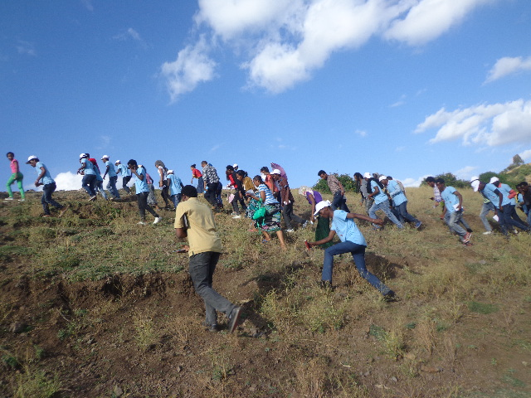
We welcome colleagues and cooperation partners to join us in extending this capacity across ECCAS and beyond.
Thank you

